Slide 1
Deep learning
Classification & Regularisation

Slide 2
Today’s program
14:00-14:15 Recap
14:15-15:00 Machine learning tasks: regression / classification
15:00-15:45 Hands-on: multiclass Fashion MNIST
15:45-16:15 Break
16:15-16:45 Optimizers, regularization techniques
16:45-17:30 Hands-on: Regularization techniques on F-MNIST
17:30-18:00 Analyzing sequential data, RNNs
18:00-19:00 Diner
19:00-19:45 Hands-on: Predicting future temperatures with an RNN
19:45-20:15 Types of RNNs: LSTM, GRU
20:15-21:00 Hands-on: creating sequences, temperature prediction with GRU-based RNN
Time left: Improving RNNs: regularization, stacking, stateful and bi-directional RNNs
Time left: Hands-on: Improved RNNs on temperature prediction

Slide 3
Today’s program
14:00-14:15 Recap
14:15-15:00 Machine learning tasks: regression / classification
15:00-15:45 Hands-on: multiclass Fashion MNIST
15:45-16:15 Break
16:15-16:45 Optimizers, regularization techniques
16:45-17:30 Hands-on: Regularization techniques on F-MNIST
17:30-18:00 Analyzing sequential data, RNNs
18:00-19:00 Diner
19:00-19:45 Hands-on: Predicting future temperatures with an RNN
19:45-20:15 Types of RNNs: LSTM, GRU
20:15-21:00 Hands-on: creating sequences, temperature prediction with GRU-based RNN
Time left: Improving RNNs: regularization, stacking, stateful and bi-directional RNNs
Time left: Hands-on: Improved RNNs on temperature prediction

Slide 4
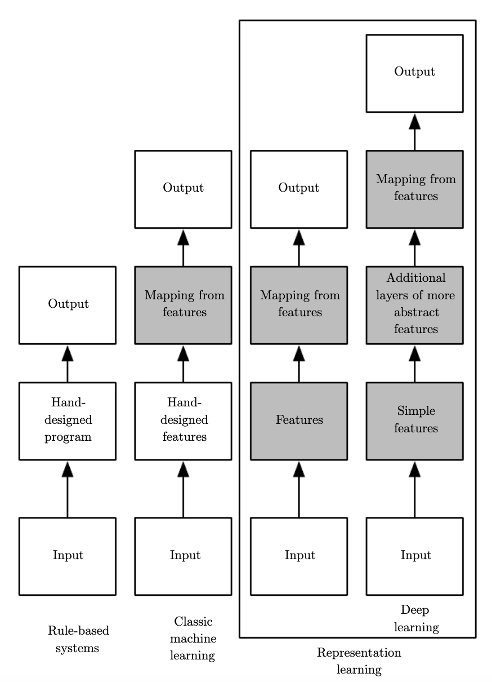
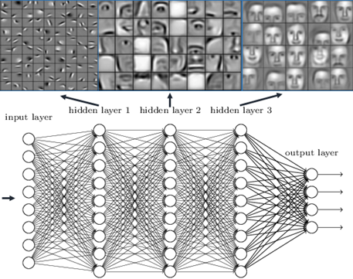
Recap: deep learning
Deep Learning abstracts low level features

Slide 5
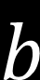


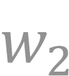



Recap: single neuron
Neuron consists of inputs, weights, bias, activation and output
$$w_{1}$$
$$\overset{m}{\underset{i=1}{∑}}w_{i}x_{i}+b$$
$$x_{1}$$
$$\hat{y}$$
$$w_{2}$$
$$x_{2}$$
$$b$$
inputs
weights
summation + bias
activation
output
Notes:
Going from left to right, from inputs to the output, we make a prediction called ˆy (‘y hat’)

Slide 6
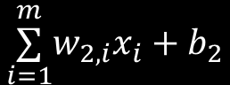
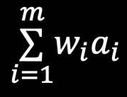

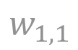

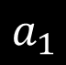
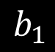
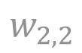
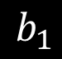

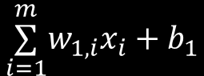
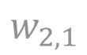

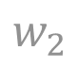
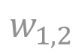
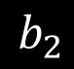
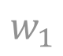
Recap: 3-neuron network
Hidden layer
Input layer
$$b_{1}$$
$$b_{1}$$
$$w_{1,1}$$
Output layer
$$x_{1}$$
$$\overset{m}{\underset{i=1}{∑}}w_{1,i}x_{i}+b_{1}$$
$$a_{1}$$
$$w_{1}$$
$$w_{2,1}$$
$$\overset{m}{\underset{i=1}{∑}}w_{i}a_{i}$$
$$\hat{y}$$
$$w_{1,2}$$
$$x_{2}$$
$$\overset{m}{\underset{i=1}{∑}}w_{2,i}x_{i}+b_{2}$$
$$w_{2}$$
$$a_{2}$$
$$w_{2,2}$$
$$b_{2}$$
Notes:
Two neurons in the hidden layer, one in the output layer
For this example and the notebook exercises, we do not have a bias or activation function in the output neuron

Slide 7
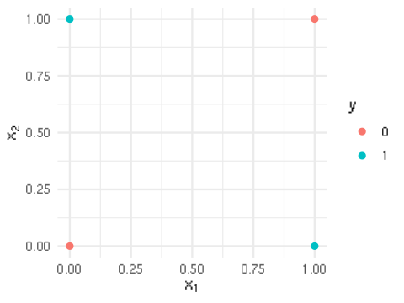
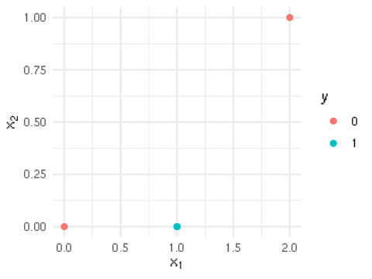
Recap: X-or problem
Inputs not linearly separable
Activations after 1 hidden layer are linearly separable
X-or problem
Activations after
1 hidden layer
x₂
a₂
x₁
a₁
Notes:
Two neurons in the hidden layer, one in the output layer
For this example and the notebook exercises, we do not have a bias or activation function in the output neuron

Slide 8
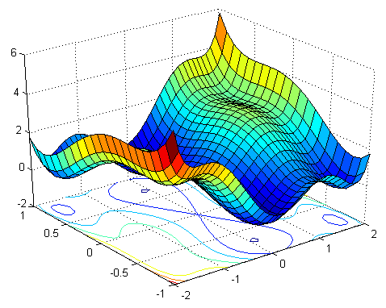
Recap: loss function
Training a neural network is finding the set of weights that minimize the loss function
Compute gradient (= steepest descent)
Take step towards gradient
Iterate
Current
weights
Gradient
Loss
w₁
w₂

Slide 9
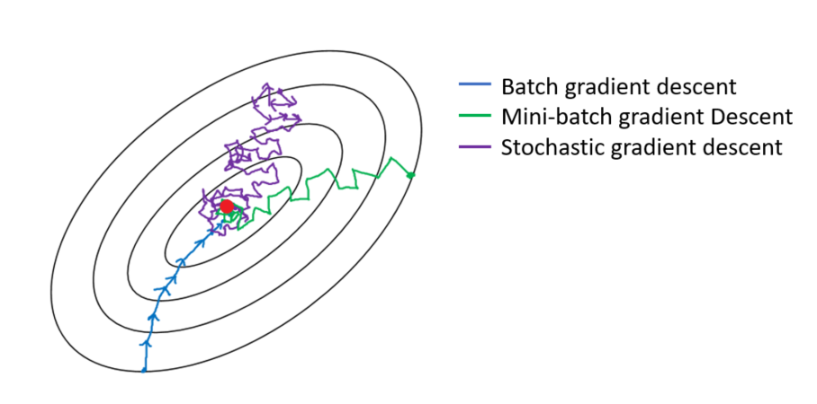
Recap: gradient update
Gradient can be computed on subset (= mini-batch) of whole dataset
Faster iterations
More ‘noisy’ estimate of the true gradient

Slide 10



Recap: dataset splits
Training / Validation / Test split typically ~ 70 / 10 / 20
Training set
Validation set
Test set
Model training
Model selection
Model testing
Best model parameters Weights
Best hyperparameters Learning rate
#neurons
#layers
Final model Accuracy
Sensitivity/specificity
Notes:
Specific to deep learning are the tweaking of the different hyperparameters, and how overfitting/underfitting develops given model capacity and optimization

Slide 11
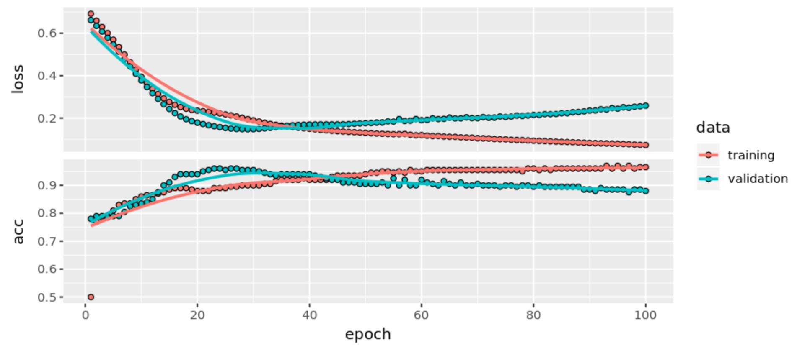
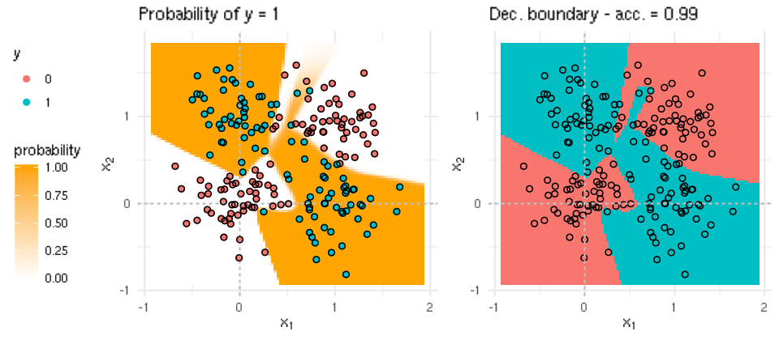
Recap: overfitting
Overfitting occurs when your model is ‘too complex’ for your problem (i.e. has too many degrees of freedom)
Validation set helps to detect overfitting: validation loss goes up
Mitigate by early stopping
Overfitting
Notes:
Specific to deep learning are the tweaking of the different hyperparameters, and how overfitting/underfitting develops given model capacity and optimization

Slide 12
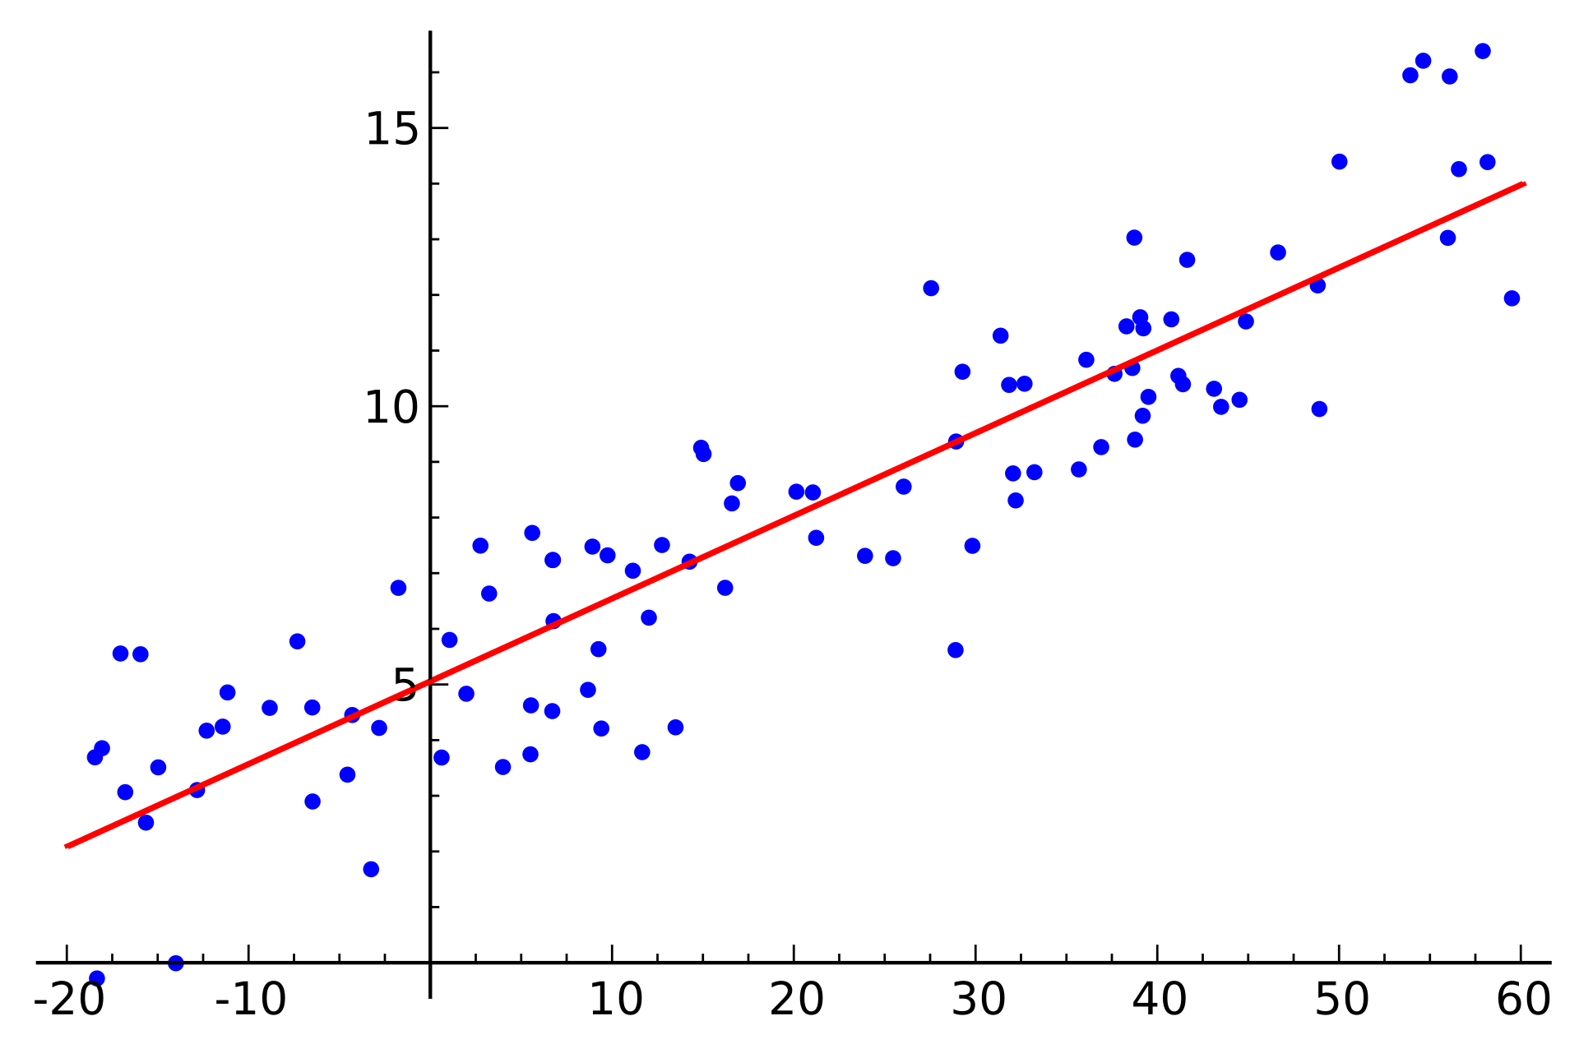
Regression
In regression the output is a single value.
Predicting house price $ given house size
y
x
Source: https://en.wikipedia.org/wiki/Regression_analysis

Slide 13
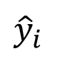
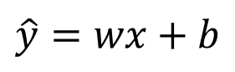
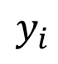
Regression
In regression the output is a single value.
Predicting house price $ given house size
y
$$\hat{y}=wx+b$$
$$y_{i}$$
$${\hat{y}}_{i}$$
x
Source: https://en.wikipedia.org/wiki/Regression_analysis

Slide 14
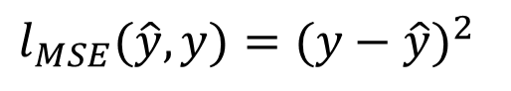
Regression
In regression the output is a single value.
Predicting house price $ given house size.
Usually Mean Square Error (MSE) is used as the loss function.
y
$$\hat{y}=wx+b$$
$$y_{i}$$
$$l_{MSE}(\hat{y},y)=(y−\hat{y})^{2}$$
$${\hat{y}}_{i}$$
x
Source: https://en.wikipedia.org/wiki/Regression_analysis

Slide 15
Regression
MSE
In regression the output is a single scalar.
Predicting house price $ given house size.
Usually Mean Square Error (MSE) is used as the loss function.
We then seek to minimise this loss.
We can represent our model as a line through our data.
y
$$\hat{y}=wx+b$$
$$y_{i}$$
$$l_{MSE}(\hat{y},y)=(y−\hat{y})^{2}$$
$${\hat{y}}_{i}$$
x
Source: https://en.wikipedia.org/wiki/Regression_analysis

Slide 16
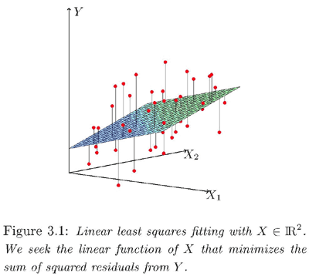
Regression
MSE
When we have more dimensions for our input we will get a hyperplane.
Source: https://onlinecourses.science.psu.edu/stat508/book/export/html/641

Slide 17
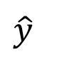
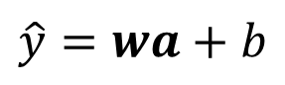
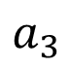
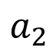
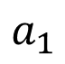
Regression
MSE in NN
To implement regression we simply add a linear regression layer as the last layer.
"layer_dense(unit = 1)"
No activation.
This can output negative, 0 and positive numbers.
$$a_{1}$$
$$a_{2}$$
$$\hat{y}$$
$$\hat{y}=wa+b$$
...
$$a_{3}$$
...

Slide 18
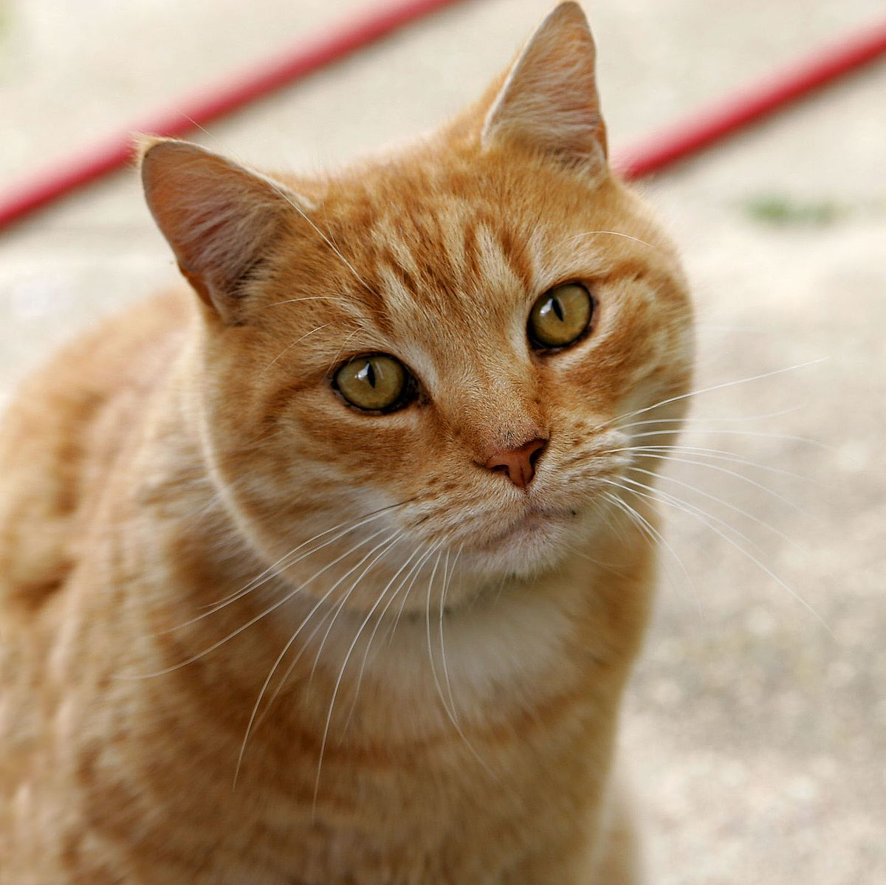
Classification
In classification we want to assign a label/category to each input.
In binary classification there are two categories and each data belongs in either category.
Spam / No-spam
Cat / No-cat
Similar to what we have done in the notebooks.
Network
Cat?
Source: The internet, really, all of it

Slide 19
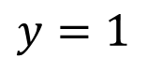
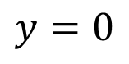
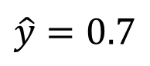
Classification
Binary classification
In classification we output a probability of belonging to a class.
Lets say that our dataset contains images which are labelled as "cat" and "not cat".
First we pre-process the labels so that "cat" is 1, and "not cat" is 0.
We will output the probability of being a cat.
Network
Probability of cat
$$y=1$$
It's a cat
$$y=0$$
It's not a cat
$$\hat{y}=0.7$$
Source: The internet, really, all of it

Slide 20
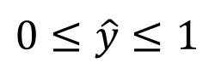
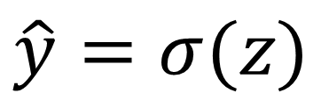
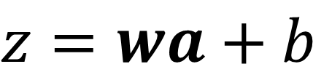
Classification
Binary classification - architecture
How do we output a probability from a neuron?
We can not simply have the output be a linear regression of last layer since it can output negative numbers and large positive numbers.
We need
To fix this we simply apply a sigmoid activation as an activation after the linear regression output, as we have already seen.
$$0≤\hat{y}≤1$$
$$z=wa+b$$
Linear regression
$$\hat{y}=σ(z)$$
Apply sigmoid after linear regression
"layer_dense(unit = 1, activation = "sigmoid")"

Slide 21
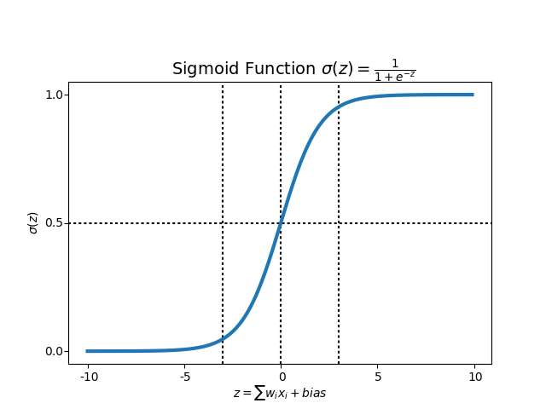
Classification
Binary classification - sigmoid

Slide 22
Classification
Binary classification - loss
Then we need to provide a loss function, since MSE is a bit too primitive for this.
The standard approach in binary classification using sigmoid is to use the following loss.
$$l(\hat{y},y)=−ylog(\hat{y})−(1−y)log(1−\overset{̂}{y})$$

Slide 23
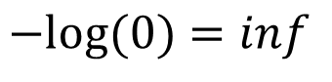
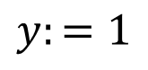
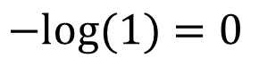
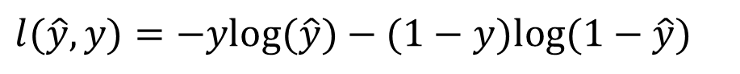
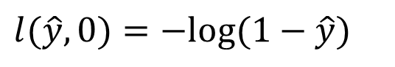
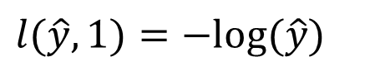
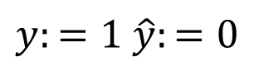
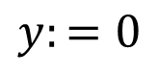

Classification
Binary classification - loss justification
To see how it works go through the cases.
This allows us to express 0 loss when making correct predictions, and infinitely large loss when making incorrect predictions.
$$l(\hat{y},y)=−ylog(\hat{y})−(1−y)log(1−\hat{y})$$
$$y:=1$$
$$l(\hat{y},1)=−log(\hat{y})$$
$$y:=0$$
$$l(\hat{y},0)=−log(1−\hat{y})$$
$$y:=1 \hat{y}:=1$$
$$−log(1)=0$$
$$y:=1 \hat{y}:=0$$
$$−log(0)=inf$$

Slide 24







Classification
Binary classification summary
We want this
Network
$$\hat{y}=p(y=1|x)$$
We can get it like this
$$a_{1}$$
$$σ(.)$$
$$\hat{y}=σ(wa+b)$$
$$a_{2}$$
$$z$$
$$\hat{y}$$
...
$$=σ(z)$$
$$a_{3}$$
We optimise it like this
$$l(\hat{y},y)=−ylog(\hat{y})−(1−y)log(1−\hat{y})$$

Slide 25
Classification
Binary classification as multi-class classification
We can also go another approach and output two values. The probability of "cat" and the probability of "not cat".
We output two things at once!
Why? This approach generalises to more classes.
In multi-class classification we want to label the input as one of multiple classes.
Probability of cat
Network
Probability of not-cat

Slide 26












Classification
One-hot encoding
If we have 5 classes, dog, cat, fish, bird and mouse.
We could represent them as 0, 1, 2, 3, 4 but that does not work well.
We would need to use regression.
We rather use one-hot encoding.
$$0$$
Not a dog
$$0$$
$$1$$
a cat
$$0$$
$$y=$$
$$0$$
Not a fish
$$y=$$
$$0$$
$$0$$
Not a bird
$$0$$
$$0$$
Not a mouse
$$1$$

Slide 27








Classification
Multiclass classification
Lets start by representing our correct labels using a vector using one-hot encoding.
This is then the true probability distribution of the example.
It's a cat!
It's not a cat!
$$0$$
$$1$$
$$y=$$
$$1$$
$$y=$$
$$0$$
$$0.23$$
$$\hat{y}=$$
$$0.77$$
Our predictions

Slide 28

Classification
Softmax layer
The dimensions of $y$ and $\hat{y}$ must match, so $\hat{y}$ must be a vector.
For $\hat{y}$ to represent probabilities there are two conditions.
The sum of all elements must be 1.
Each element needs to be in the range [0;1].
The Softmax layer ensures that these properties are present.

Slide 29






Classification
Softmax properties
$${\hat{y}}_{1}+{\hat{y}}_{2}=0.23+0.77=1$$
1. Check
$$0.23$$
$$\hat{y}=$$
$$0.77$$
$$0≤{\hat{y}}_{1}≤1$$
2. Check
Our predictions
$$0≤{\hat{y}}_{2}≤1$$

Slide 30




Classification
Mathematics of softmax
First output two real values,
Then normalise these values and deal with negative values.
$$z_{1}=w_{1}a+b_{1}$$
$$z_{2}=w_{2}a+b_{2}$$
$$y_{1}=a_{1}=\frac{e^{z_{1}}}{\sum_{i=1}^{2}{e^{z_{i}}}}$$
$$y_{2}=a_{2}=\frac{e^{z_{2}}}{\sum_{i=1}^{2}{e^{z_{i}}}}$$
"layer_dense(unit = 2, activation = "softmax")"

Slide 31








Classification
Multiclass classification
We can now output $\hat{y}$ as a probability distribution and represent $y$ using one-hot encoding, the true/correct distribution.
Now we need a loss function to train our model.
We borrow from information theory, there we have a function which compares two probabilities distributions, the categorical cross-entropy function.
It's a cat!
$$0$$
$$0.23$$
$$y=$$
$$\hat{y}=$$
$$1$$
$$0.77$$
Our predictions
$$l(\hat{y},y)=−y⋅log(\hat{y})$$
$$l(\hat{y},y)=−y⋅log(\hat{y})=−∑_{i=1}^{2}y_{i}log({\hat{y}}_{i})=−y_{1}log({\hat{y}}_{1})−y_{2}log({\hat{y}}_{2})$$

Slide 32












Classification
Multiclass classification
One-hot-encoding of categorical value.
The true probability distribution.
By minimising categorical cross entropy between these two distributions, we are trying to make them as similar as possible.
We output a distribution
and then take the log of the values
Correct
$$\hat{y}$$
$$y$$
$$0.03$$
$$0$$
Dog
$$0.17$$
$$0$$
Mouse
$$0.3$$
$$0$$
Whale
$$0.5$$
$$1$$
Cat
Loss is only computed w.r.t. correct class since only then
$$y_{i}=1$$
$$l(\hat{y},y)=−y⋅log(\hat{y})=−∑_{i=1}^{c}y_{i}log({\hat{y}}_{i})$$

Slide 33
Summary
Multiclass classification
One-hot-encoding of categorical value.
The true probability distribution.
We just saw that we can make our network output a vector. Powerful stuff!
We even constrain that vector to have certain properties, softmax.
We saw one-hot encoding.
We saw the categorical cross entropy loss function.
We output a distribution
and then take the log of the values
Correct
$$\hat{y}$$
$$y$$
$$0.03$$
$$0$$
Dog
$$0.17$$
$$0$$
Mouse
$$0.3$$
$$0$$
Whale
$$0.5$$
$$1$$
Cat
Loss is only computed w.r.t. correct class since only then
$$y_{i}=1$$
$$l(\hat{y},y)=−y⋅log(\hat{y})=−∑_{i=1}^{c}y_{i}log({\hat{y}}_{i})$$

Slide 34

Hands-on
Go to https://jupyter.lisa.surfsara.nl:8000/
Or https://dba.projects.sda.surfsara.nl/
Notebook: 03a-fashion-mnist-multiclass.ipynb
15:00-15:45

Slide 35
Today’s program
14:00-14:15 Recap
14:15-15:00 Machine learning tasks: regression / classification
15:00-15:45 Hands-on: multiclass Fashion MNIST
15:45-16:15 Break
16:15-16:45 Optimizers, regularization techniques
16:45-17:30 Hands-on: Regularization techniques on F-MNIST
17:30-18:00 Analyzing sequential data, RNNs
18:00-19:00 Diner
19:00-19:45 Hands-on: Predicting future temperatures with an RNN
19:45-20:15 Types of RNNs: LSTM, GRU
20:15-21:00 Hands-on: creating sequences, temperature prediction with GRU-based RNN
Time left: Improving RNNs: regularization, stacking, stateful and bi-directional RNNs
Time left: Hands-on: Improved RNNs on temperature prediction

Slide 36
Improving networks
We can split up the ways to improve networks to two categories (some belong in both categories).
Speed up learning while training the network.
Advanced optimisers (using momentum and per parameter step size)
Input data normalisation
Batch normalisation
(weight initialisation)
After we have fit the training data, we want to focus on reducing overfitting.
L1/L2 regularisation
Dropout

Slide 37

Optimisers
Speeding up learning
In practice we don't just use mini-batch gradient descent but more dynamic implementations.
Some optimisers have been shown to do well for certain architectures.
Source: http://ruder.io/optimizing-gradient-descent/index.html

Slide 38

Optimisers
Speeding up learning
Some feature momentum which takes the previous updated values into account (exponentially decaying averages).
Source: https://cs231n.github.io/neural-networks-3/

Slide 39

Optimisers
Speeding up learning
And feature sensitive step sizes, which perform smaller updates (you can think of it as lower learning rate) for frequent features and larger for more unfrequent features.
Adam has been shown to be a good general choice.
Source: http://ruder.io/optimizing-gradient-descent/index.html

Slide 40
Input normalisation
Speeding up learning
We have already covered input normalisation.
As a preprocessing stage for the input features.
This has been shown to speed up training of neural networks.
All features should have the same range.
Mean 0, variance 1.
We can use the "scale" function or in some cases (f.ex. images) divide by 255.

Slide 41





Input normalisation
Speeding up learning
$$w_{1}$$
$$w_{1}$$
$$w_{2}$$
$$w_{2}$$
Source:
https://www.jeremyjordan.me/batch-normalization/

Slide 42
Batch normalisation (BN)
Speeding up learning
Why only do this normalisation on the input?
In 2015 it was shown that renormalising in an intermediary layer speeds up learning.
We compute the mean and variance per batch and uses it to normalise to 0 mean and variance 1.

Slide 43

Source:
https://wiki.tum.de/display/lfdv/Batch+Normalization

Slide 44

Batch normalisation (BN)
Speeding up learning
We might not always want 0 mean and variance 1 so we add two more parameters to scale the values out again.
$γ$ and $β$ are parameters learnt by the model, 2 per neuron.
Worst case scenario, BN is not helpful at all and the model will just learn the mean and variance of the batches.

Slide 45

Batch normalisation (BN)
Speeding up learning
Source:
https://wiki.tum.de/display/lfdv/Batch+Normalization

Slide 46
Batch normalisation
Speeding up learning
Adding BN will add more parameters to the model and extra computation.
BN allow us to more easily train deeper networks.
BN makes the network more robust to hyperparameter selections.
BN allows us to train with a higher learning rate.
layer_dense(unit = 10)
layer_batch_normalization()
layer_activation_relu()

Slide 47
Regularisation
Reducing overfitting
What is regularisation?
Any kind of technique which helps reduce overfitting
Examples:
Early stopping
L2 regularization (extra loss term)
Dropout (extra layer)

Slide 48

L2 Regularisation
Fitting with M-th order polynomial

Slide 49

L2 Regularisation
Reducing overfitting
We add a new term to the total loss function.
This term adds additional loss to the function which takes the size of the weights into account.
We then optimise this new loss function instead.
A new hyperparameter, $λ$ is added. This is usually a small value and we will need trial and error to find an acceptable value.

Slide 50


L2 Regularisation
Reducing overfitting
Why does L2 regularisation work?
We add a cost to the weights: large weights “cost” more.
Thus, our model is ‘forced’ to reduce (absolute) size of the weights.
This restricts the range of possible weights, reducing the model’s complexity
In addition, when weights are forced to 0, connections are effectively removed (also reduces model complexity.
$$a$$
Set weight to 0
$$a$$

Slide 51
L2 Regularisation
Reducing overfitting
We use L2 regularisation to fight overfitting, because it makes our model less expressive.
It will increase the training loss during training and hopefully reduce the test loss.
L2 regularisation is also known as weight decay.
$$a$$
Set weight to 0
$$a$$

Slide 52








L2 Regularisation
Reducing overfitting
$$w$$
$$f(x_{i},w)$$
$${\hat{y}}_{i}$$
$$l({\hat{y}}_{i},y_{i})$$
$$x_{i}$$
$$y_{i}$$
$$Total loss=J(w)=\frac{1}{n}∑_{i}^{n}(l(f(x_{i},w),y_{i})$$
Now becomes
$$J(w)=\frac{1}{n}∑_{i}^{n}(l(f(x_{i},w),y_{i})+λ∑_{j}w_{j}^{2}$$

Slide 53

Dropout
Reducing overfitting
Dropout is a similar form of regularisation. It will randomly set the activations of neurons to 0.
Source:
Srivastava et al., 2014, "Dropout: A Simple Way to Prevent Neural Networks from Overfitting"

Slide 54






Dropout
Reducing overfitting
This reduces dependance on specific features thus making the network more robust.
The fraction of neurons we set to 0 for each layer is a new hyperparameter which is also found by trial and error (usually between 0.5 and 0.2).
We apply dropout after the activations.
This has been shown to increase performance during test time. Note: during test time, no activations are dropped!
$$a_{1}$$
$$a_{2}$$
$$a_{3}$$
Set activation to 0
$$a_{1}$$
$$a_{2}$$
$$a_{3}$$

Slide 55
Summary
Use Adam.
Normalise input.
Apply BN before activations.
Use L2 regularisation.
Apply Dropout after activations.
These techniques will make your loss function a lot noisier (higher variance), but we will perform better during test time.

Slide 56
Hands-on
Go to https://jupyter.lisa.surfsara.nl:8000/
Or https://dba.projects.sda.surfsara.nl/
Notebook: 03b-regression-regularisation.ipynb
16:45-17:30

Slide 57
Notebook recap
We were not really able to improve the baseline much, but made it converge faster.
We saw that we really need to test if the regularisation technique is helping us.
L2 regularisation was not very stable. Dropout was better.
It depends on the task, architecture, ..., trial and error.

Slide 58
Summary
Machine learning tasks
Regression
Binary classification
Multi-class classification
Improving networks
Preventing overfitting = Regularisation, dropout
Speeding up learning = Advanced optimisers, batch normalisation

